Slide 1
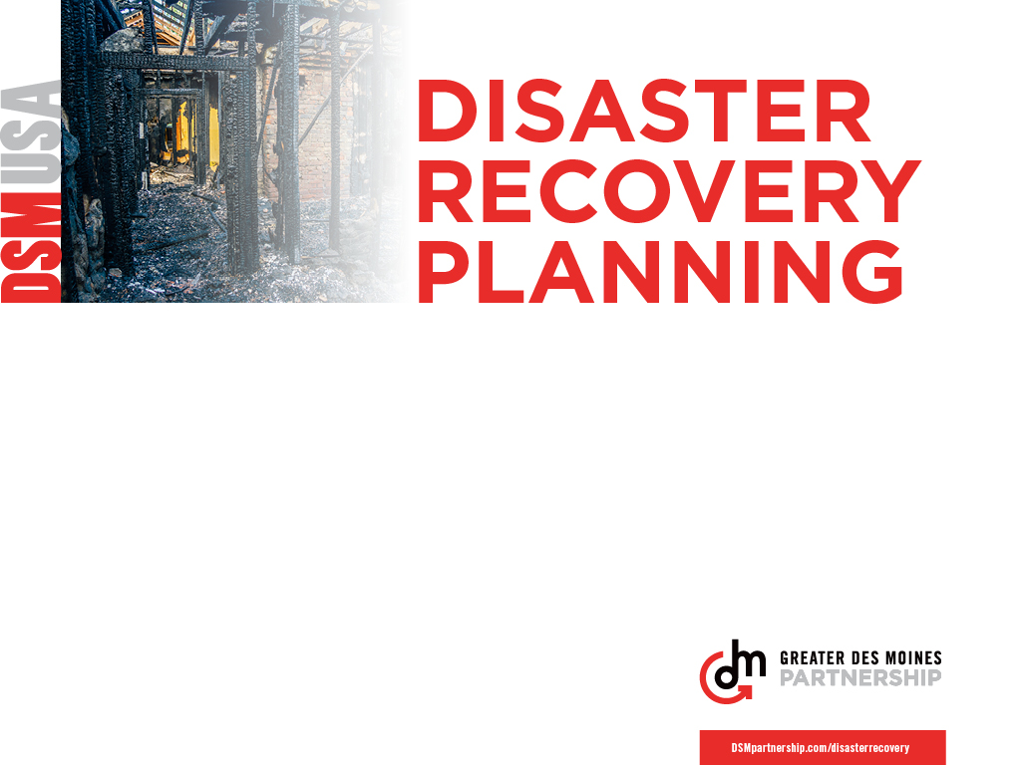
Be Prepared. The following pages contain verbiage, tips, and other articles and resources around the topic of preparedness that you can reference and share with your co-workers and employees.

Slide 2

What and Why
Disaster can strike at any time. It could be small and cause some minor inconvenience and disruption, or it could be devastating and the business may never recover. Incidents can happen at home too, and in our community at large. This month, we will take time to assess where we may be vulnerable, take steps to shore up weaknesses, and create plans for dealing with and recovering from whatever comes our way.

Slide 3
Ideas for activities
Sign up for Code Red- Sign up to receive community notifications system available to local residents for communicating critical and time-sensitive information. Register your cell phone for this service to received targeted notifications that directly impact your home or business. https://www.polkcountyiowa.gov/emergency-management.
Take Inventory- Have each team member take inventory of their work area and document both the company-owned and personal contents. Encourage team members to do this for their home as well. Templates can be found on the internet, or provided by your insurance carrier. Keep a copy of this information with your disaster recovery plan and in a back up area such as an app or cloud storage so that it can be accessed remotely.

Slide 4
Ideas for activities
Review and Refresh- Take time at a team meeting to start drafting a plan or review your current plan. Break into teams to more quickly accomplish the task, create an opportunity for team members to work together, and to have a variety of perspectives reviewing each section. Have teams share their findings and outline for their portion of the plan Send calendar invites to review and update the plans on a semiannual basis.
Make a Plan for Home – Encourage team members to make a disaster preparedness and recovery plan for home and family. Ask each team member to share one tip or one discovery at the next team meeting.

Slide 5
Resources
Videos
Ready Houston’s: RUN. HIDE. FIGHT. Surviging an Active Shooter Event
Oregon has created a series of videos: Preparedness Videos for Staff Meetings .
Posters
Ready.gov offers posters on a variety of topics: https://www.ready.gov/publications
We Prepare Every Day Inclusive Emergency Preparedness Poster: https://www.fema.gov/media-library/assets/documents/117439

Slide 6
Resources
Other tools
U.S. Chamber of Commerce Foundation’s Resilience in a Box: https://www.uschamberfoundation.org/resilience-box
Department of Homeland Security’s Make a Plan: https://www.ready.gov/plan
FEMA’s How to Make a Disaster Plan: https://www.fema.gov/news-release/2018/03/29/how-make-disaster-plan
Safeguard Iowa Partnership’s Business Emergency Guide: https://www.polkcountyiowa.gov/media/438675/sip-business-emergency-guide-version-20-4.pdf
Active Shooter Preparedness: https://www.dhs.gov/cisa/active-shooter-preparedness

Slide 7
Tips and reminders
Review your insurance. It is important to have an understanding what is covered and what is not. Don’t fall into the trap of thinking that insurance is too expensive. Talk through options with a broker. Even covering just the basics can help you get up and running faster.
Create a rainy-day fund. In business, having reserves could help you make payroll. At home, it could help pay for repairs or bridge other gaps.
Follow the experts on social media. Local news outlets, National Weather Service, your County Emergency Management, Safeguard Iowa Partnership, and others are good organizations to track to stay current.
Flooding is commonplace in Iowa. Never walk, swim, or drive through flood waters. Just six inches of moving water can knock you down, and one foot of moving water can sweep your vehicle away. Turn Around, Don’t Drown!

Slide 8
MORE Tips
Get to know neighbors and check on them before and after a disaster.
According to Department of Homeland Security, 44 percent of small businesses reported being the victim of a cyber attack, with an average cost of approximately $9,000 per attack.
Know how to shut off utilities where you live and work.
Generators should always be used outside the home. Carbon monoxide poisoning can occur when a generator is not working, or vented, properly.
Know a safe location in your home and your workplace in case there is a tornado.
Extreme heat can be deadly. Drink plenty of water throughout the day. Take advantage of city cooling centers, public pools and other air-conditioned public places.
Help your children memorize emergency contacts or write them in a secure place.

Slide 9
More tips
Clean up. Look around storage areas, purge what you no longer need, properly store what you want to keep. Consider using watertight totes and shelving for proper storage and a higher survival rate for items.
Back up. What key pieces of data are essential to business or personal operations? Ensure regular back ups or logging of items such as this. Consider storing copies in multiple locations.
Is your location prone to flooding? Updated flood maps can help you understand your risk. https://ifis.iowafloodcenter.org/ifis/maps/
Unfortunately, mass shootings are on the rise. Review the Department of Homeland Security’s Active Shooter Event Guide and remember, Run, Hide, Fight.
Know two ways out of every room in your home and office. Considering drawing up an easy to understand map of the routes and share them with others.

Slide 10
More tips
Establish an outside meeting place for fires/fire drills. When the smoke alarm sounds get outside and stay outside. Go to your outside meeting place until responders indicate you may return.
If your company’s data systems have been compromised, inform local law enforcement or the state attorney general as appropriate. Report stolen finances or identities and other cyber crimes to the Internet Crime Complaint Center at www.ic3.gov.
When an emergency occurs, the need to communicate is immediate. Take the time to create templates for different scenarios and different audiences in advance.
Never self-deploy to a disaster site to help. As Iowans, we always want to jump in and help, especially in time of crisis; but it is much more helpful to go through organizations leading the recovery efforts.

Slide 11
More tips
Never seek shelter from a tornado under a bridge or overpass. You are much safer in a low and flat location.
Being constantly connected can make life more efficient, but it also increases risk of cybersecurity threats. Understand the devices and apps you use every day to help keep you and your information safe and secure.
Medical emergencies can happen from anytime, anywhere. You play a role in calling 911 and supporting the victim until first responders arrive. Never move the victim, and never provide any first aid beyond your training.
Apps can help with organization and communication. EMC Insurance offers a few loss control apps including the OFB-EZ Mobile™ app that can help you create, house and communicate your plan.
Create phone-tree strategies, group email and group texting strategies to help communicate during emergencies.

Slide 12
More tips
In an active shooter event, the first officers to arrive on scene will not stop to help the injured. Expect rescue teams to follow initial officers. These rescue teams will treat and remove injured.
If you or someone close to you has a disability or a special need, you may have to take additional steps to prepare for emergencies. Create a network of neighbors, relatives, friends, and coworkers to aid you in an emergency.
Use unique passwords and change passwords every three months. Consider implementing multi-factor authentication that requires additional information beyond a password to gain entry. Check with your vendors that handle sensitive data, especially financial institutions, to see if they offer multi-factor authentication for your account.
Learn first aid and CPR from your local Red Cross chapter or other community organizations.

Slide 13
More tips
When electricity is lost for several hours or days, frozen and refrigerated food may not be safe to eat. Do not re-freeze thawed food. Throw away all food that has been under flood waters, except canned food, but wash and sanitize the cans before opening.
As you plan, think about a disaster as anything that disrupts normal operations with employees, customers, and your supply chain.
Calling 211 will put you in touch with a wide array of community supports and resources. Keep this in mind as you need help recovering from disaster, and much more.

Slide 14
Appendix
We can’t take all of the credit. In compiling this information, we referenced the following organizations and websites:
FEMA.gov
Ready.gov
SafeGuardIowa.org
IBHS.org
IowaFloodCenter.org
PolkCountyIowa.gov/emergency-management
USChamberFoundation.org/topics/disaster-response
SBA.gov/business-guide/manage-your-business/prepare-emergencies
DHS.gov/publication/active-shooter-pamphlet
DHS.gov/cisa/workplace-violence
US-CERT.gov
FCC.gov
DisasterSafety.org

